Slide 1

CyberSafe: An Intelligent Framework for Automated Phishing Detection using Machine Learning
Under the guidance of Prof. SHRUTHI G
Submitted By
Abhishek K-1MS20IS003
Adithya G- 1MS20IS007
Yadiki Janvith Royal– 1MS20IS136
Swamy Naga Gana Teja CH-1MS20IS121
Dept of Information Science & Engineering
Seminar - ISE

Slide 2
INDEX
SL NO | TOPIC | SLIDE.NO
1. | Problem statement | 3
2. | Motivation | 4
3. | Objective | 5
4. | Dataset description | 6
5. | Implementation | 7-10

Slide 3
Problem Statement
Create an intelligent system using AI/ML to detect phishing domains which imitate look and feel of genuine domains

Slide 4
Motivation
Phishing attacks remain at the forefront of cybersecurity threats, with countless users worldwide falling victim to them every day.
These phishing domains, spread through various mediums such as email and SMS, can cunningly mirror genuine websites, particularly login pages.
Unsuspecting users can inadvertently disclose their credentials on these malicious sites or even inadvertently trigger the download of harmful payloads onto their devices.
With the proliferation of these threats, it is imperative to devise an intelligent system capable of pinpointing phishing domains, thereby protecting users from potential security breaches.

Slide 5
Objective
Develop Innovative Detection Techniques: Explore and develop novel machine learning algorithms and techniques specifically tailored for phishing URL detection, surpassing the limitations of traditional methods.
Enhance Accuracy and Precision:Aim to achieve high accuracy and precision in distinguishing between legitimate and phishing URLs, minimizing false positives and false negatives.
Address Dynamic Phishing Tactics:Develop strategies to keep pace with evolving phishing tactics by continuously updating and adapting detection algorithms to new patterns and methods used by cybercriminals.
Handle Imbalanced Datasets:Implement techniques to address class imbalance in phishing detection datasets, ensuring fair representation and reliable performance across both legitimate and phishing URLs.
Optimize Feature Selection:Explore feature engineering methods to identify and select informative features relevant to phishing detection, reducing dimensionality while maintaining detection effectiveness.
Enable Real-time Detection:Design and implement algorithms capable of real-time phishing URL detection, suitable for integration into web browsers, email clients, and network security tools for proactive defense.

Slide 6
Phishing Websites Dataset Description:
Source:
Datasets collected from sources such as www.phishtank.com.
Attributes/Features:
Domain-related features: domain length, presence of hyphens, etc.
SSL certificate information: whether the website uses HTTPS, certificate expiration date, etc.
WHOIS data: registration information, creation date, etc.
HTML content analysis: presence of certain keywords or patterns.
IP address information: location, hosting provider, etc.
Presence of phishing-related keywords in the URL or webpage.
Labels:
Binary labels indicating whether a website is legitimate or a phishing site.

Slide 7
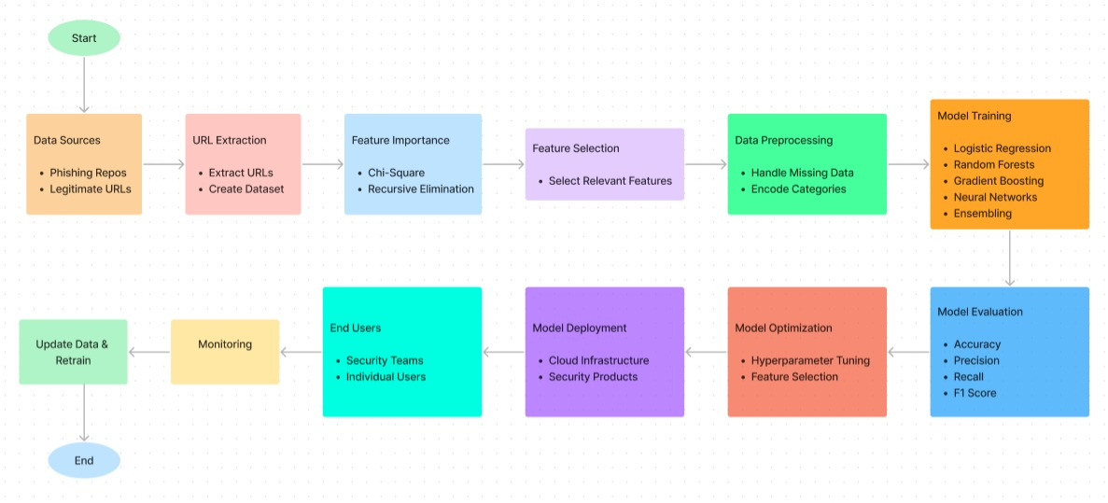
Methodology

Slide 8
Implementation
Data Acquisition and Preprocessing: Utilized a dataset from PhishTank, a reputable source of labeled phishing URLs, ensuring quality data for model training and testing.
Employed data cleaning techniques like handling missing values, encoding categorical features, and normalization to prepare the dataset for analysis.
Feature Engineering and Selection:
Extracted important features from URLs, including URL-based, domain-based, traffic-based, and content-based features, to capture phishing characteristics effectively.
Used feature selection methods such as Chi-Square Test and Recursive Feature Elimination (RFE) to identify the most informative features while minimizing redundancy.

Slide 9
Model Training and Evaluation:
Explored a variety of machine learning classifiers such as Logistic Regression, Gradient Boosting, XGBoost, SVM, Decision Tree, Random Forest, MLP, Naive Bayes, and KNN for phishing URL detection.
Split the dataset into training and testing sets (80-20 split) to train models and evaluate their performance using metrics like precision, accuracy, recall, and F1-score.
Model Comparison and Selection:
Compared the performance of different models to identify the best-performing model in accurately classifying phishing and legitimate URLs.
Selected the most suitable model based on performance metrics for deployment in real-world scenarios.

Slide 10
Ensemble Learning for Improved Performance:
Implemented ensemble learning using a voting classifier with well-performing models like RandomForest, GradientBoosting, XGBoost, CatBoost, and Decision Tree.
Leveraged the strengths of individual classifiers to enhance overall performance in distinguishing between phishing and legitimate URLs, ensuring robustness and accuracy in detection.

Slide 11
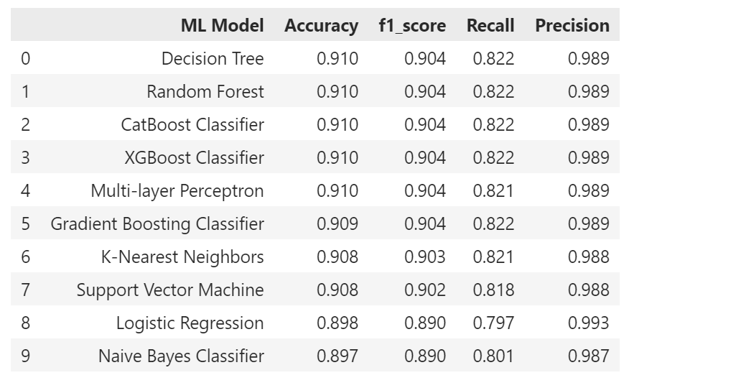
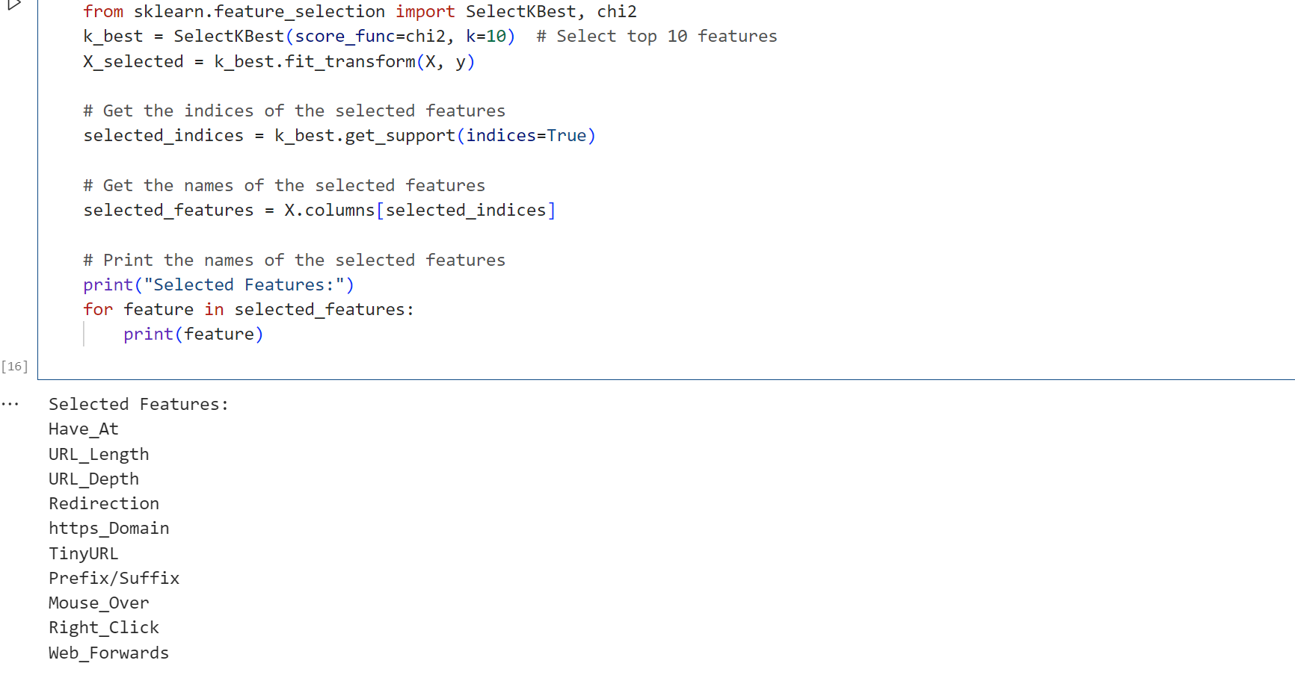

Slide 12
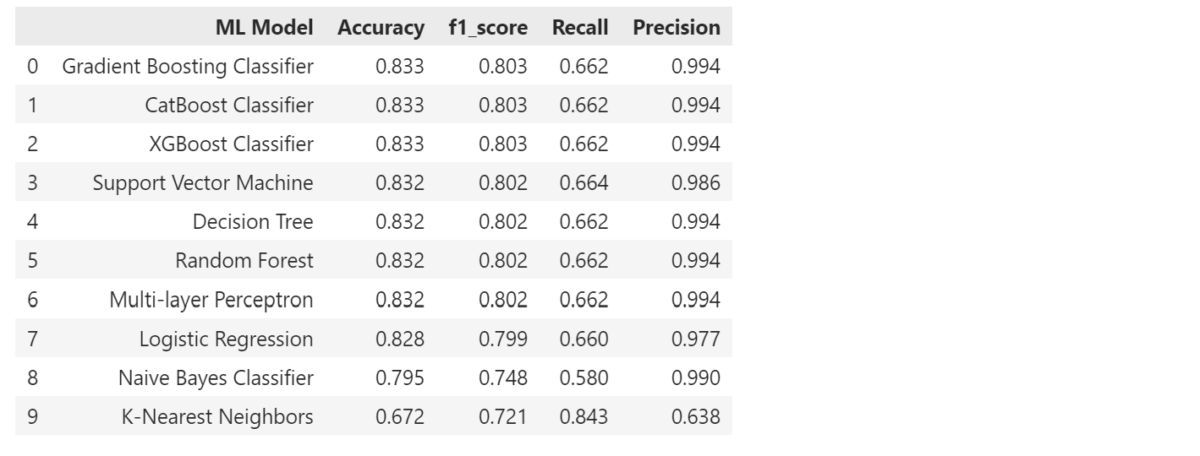
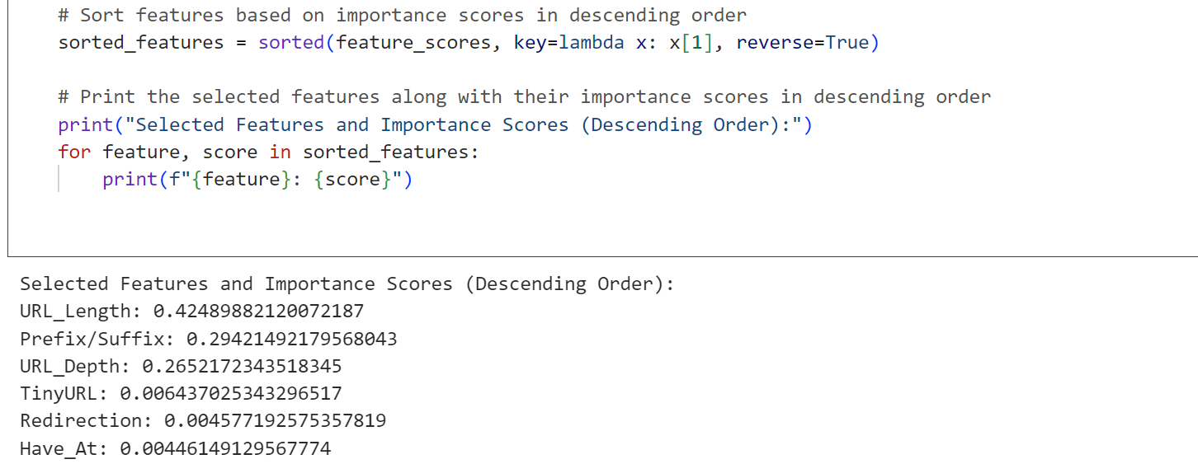

Slide 13
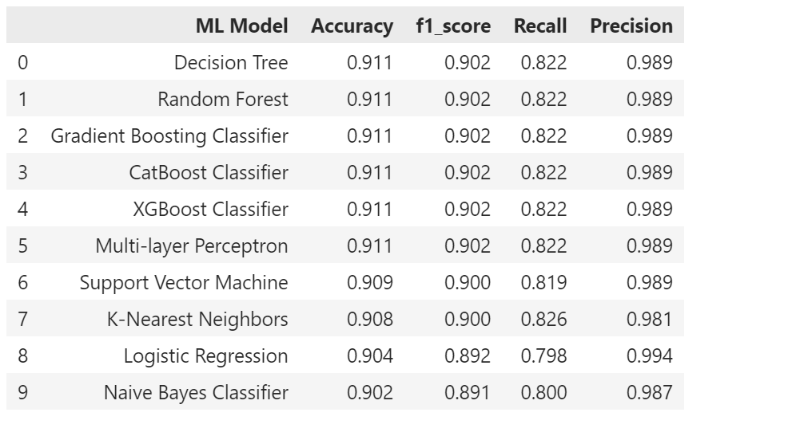
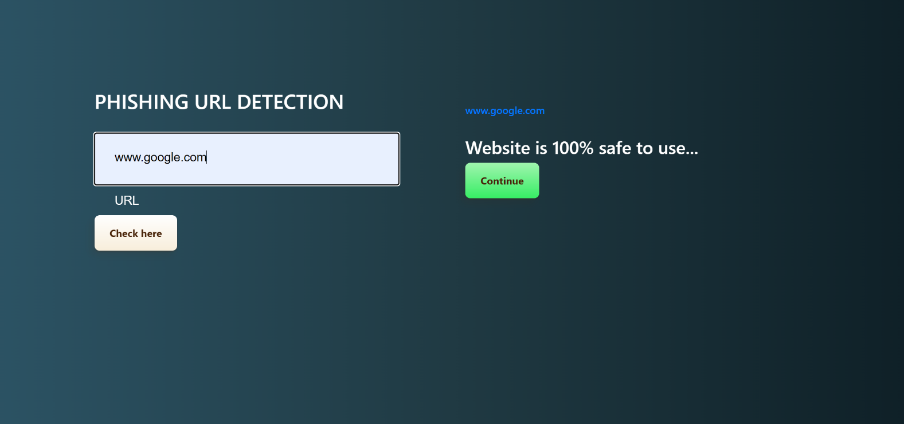

Slide 14
Thank You

